Slide 1
The Machine Learning & Deep Learning Show
Lecture 01 11th June 2020

Slide 2
Congratulations!
Acceptance Rate 12%
4
Countries

Slide 3

About this Course / Program
FUN
Motivation Running a full suite Machine Learning leading to real value creation with Hands-on experience
R E S E A R C H
Strong Community Engagement
The Machine Learning & Deep Learning Show: Lecture 01

Slide 4
The Machine Learning & Deep Learning Show
Lecture 01 11th June 2020

Slide 5



Instructors
Vedant Bahel
Microsoft Student Partner Founder, Data Deals #Researcher @Vedant_Bahel
Harsh Aryan
Microsoft Student Partner Google Explore ML Facilitator #TechEvangelist @12HarshAryan
The Machine Learning & Deep Learning Show: Lecture 01

Slide 6
Agenda
Intro to Machine Learning
Intro to Deep Learning
Types of Machine Learning System
Supervised Machine Learning
Regression
Hands-On
About Assignment 1

Slide 7
What is Machine Learning ?
First Questions first

Slide 8

What is Machine Learning ?

Slide 9
What is Machine Learning ?
Machine learning is a specific field of AI where a system learns to find patterns in examples in order to make predictions.
It can be understood as Computers learning how to do a task without
'being explicitly programmed' to do so.

Slide 10
What is Machine Learning ?
Machine Learning Algorithms are those that can tell you something interesting about the data (patterns !), without you having to write any custom code specific to the problem.
Instead of writing code explicitly, we feed data to these ML algorithms and they build their own logic based on the data and its patterns.

Slide 11
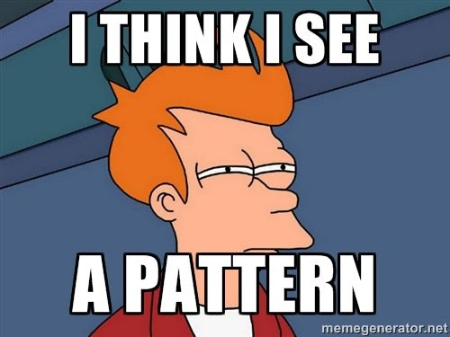
What is Machine Learning ?
Hence, ML is the “Art of Seeking Information and Meaning from Data”

Slide 12
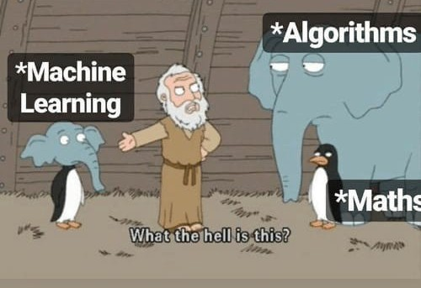
What is Machine Learning ?

Slide 13
Some Applications of Machine Learning

Slide 14
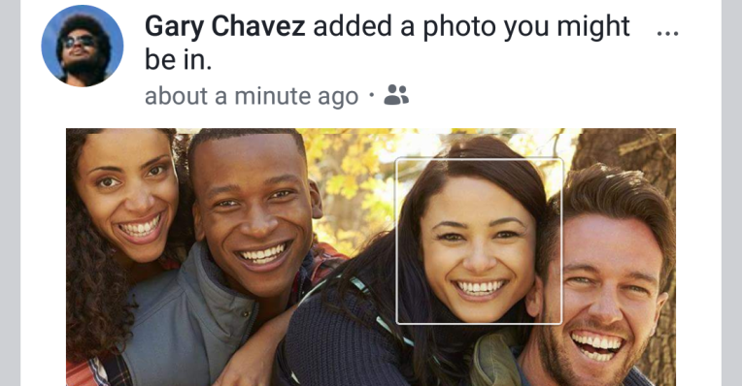

Photo Tagging
The Machine Learning & Deep Learning Show: Lecture 01

Slide 15
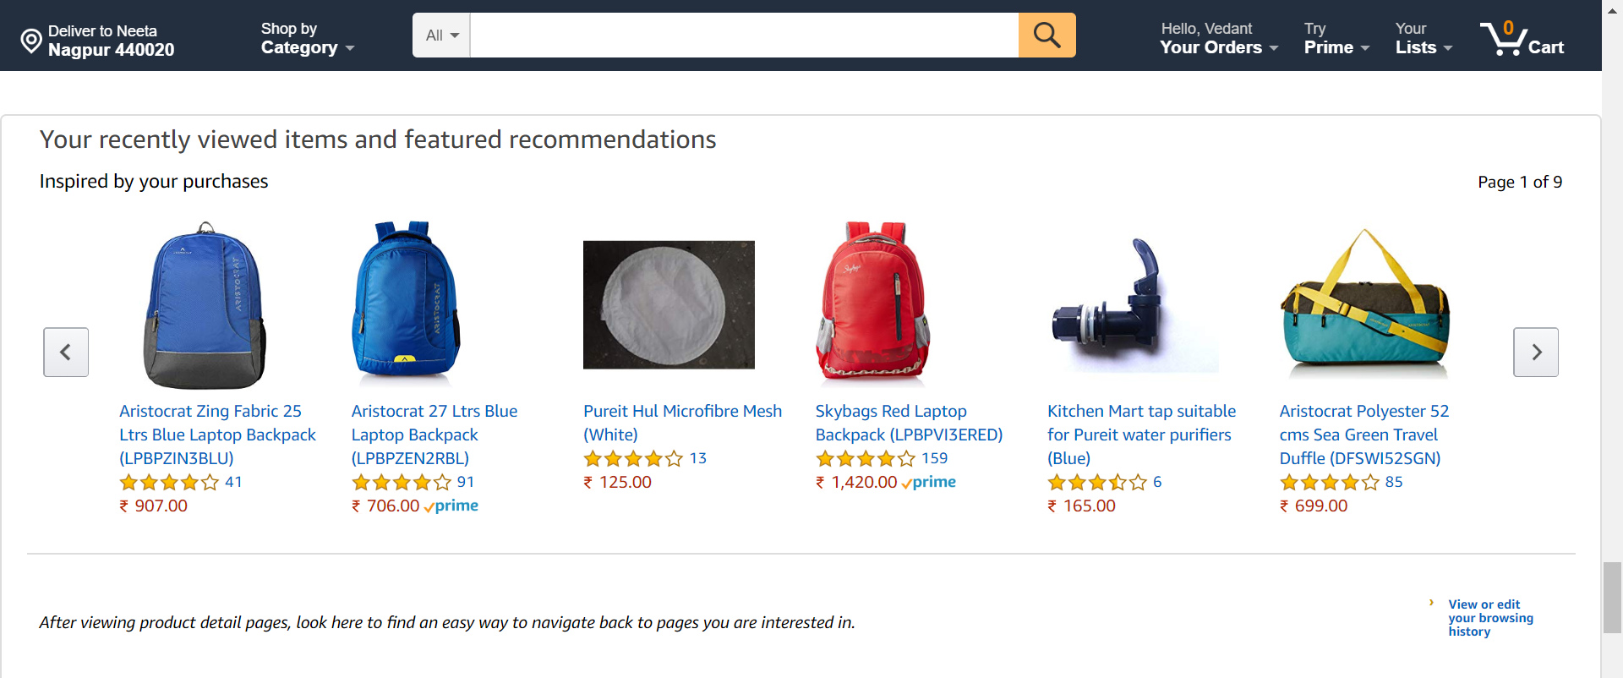
Product Recommendation
The Machine Learning & Deep Learning Show: Lecture 01

Slide 16
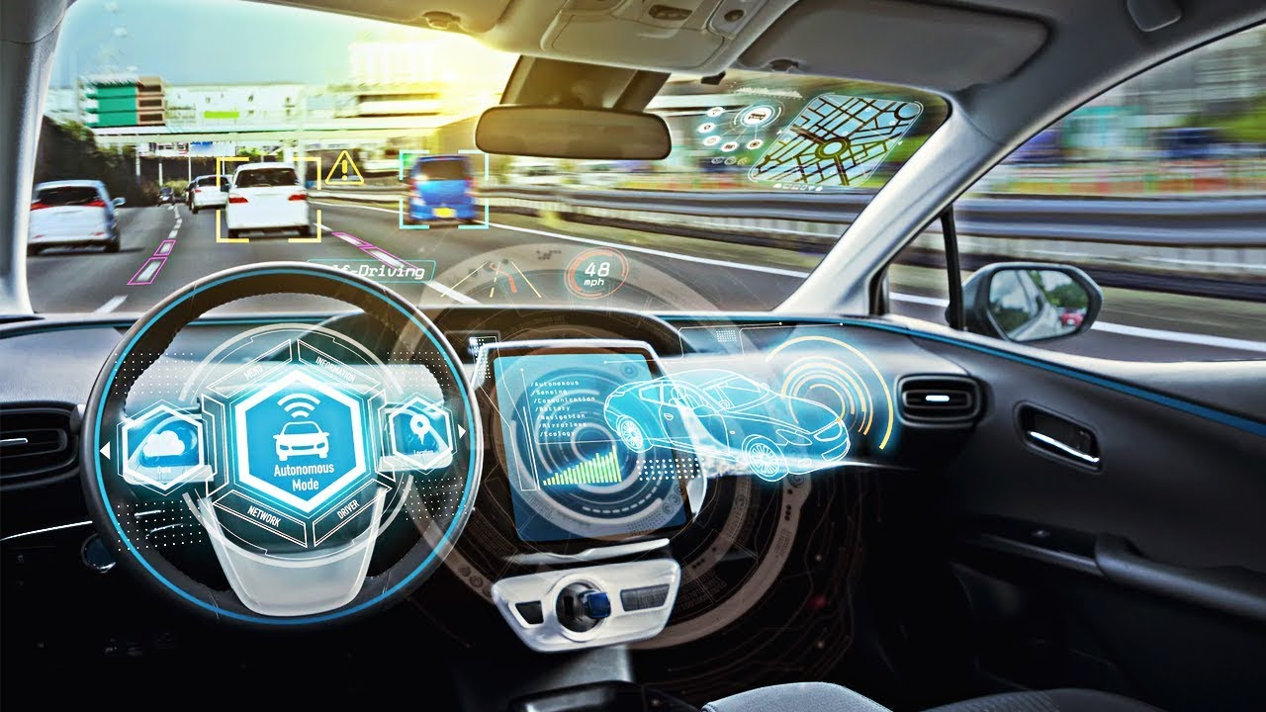
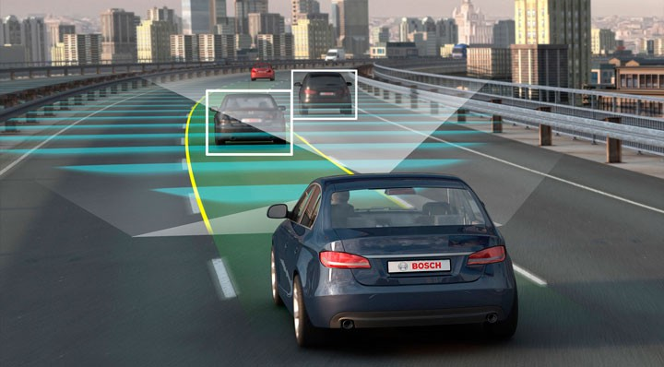
Self Driving Car
The Machine Learning & Deep Learning Show: Lecture 01

Slide 17
What are your favorite application of Machine Learning? Write it down in the chat/comment section below

Slide 18
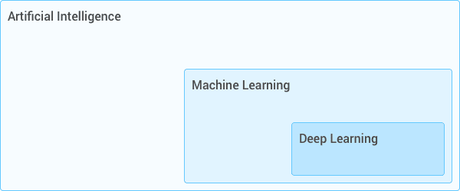
Some more terms
The Machine Learning & Deep Learning Show: Lecture 01

Slide 19

Some more terms
The Machine Learning & Deep Learning Show: Lecture 01

Slide 20

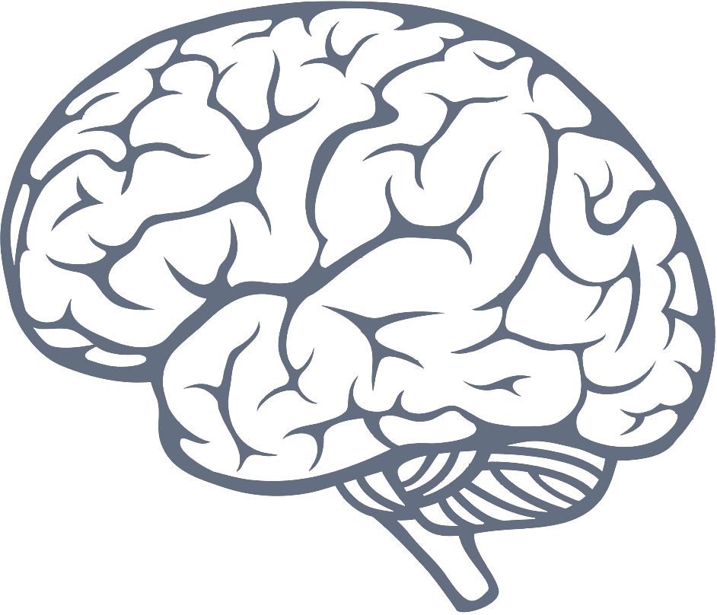
Deep Learning
What is Neural Networks?
The Machine Learning & Deep Learning Show: Lecture 01

Slide 21
Types of Machine Learning System
Supervised Machine Learning
Unsupervised Machine Learning
Deep Learning
Reinforcement Learning
Machine Learning
The Machine Learning & Deep Learning Show: Lecture 01

Slide 22
Types of Machine Learning System
Unsupervised
Unsupervised learning is when we are dealing with data that has not been labeled or categorized.
Supervised
Supervised learning algorithm takes labeled data and creates a model that can
make predictions given new data. Deep Learning
Deep learning utilizes neural networks which, just like the human brain, contain interconnected neurons that can be activated or deactivated.
Reinforcement
Reinforcement learning uses a reward system and trial-and-error in order to maximize the long-term reward.
The Machine Learning & Deep Learning Show: Lecture 01

Slide 23
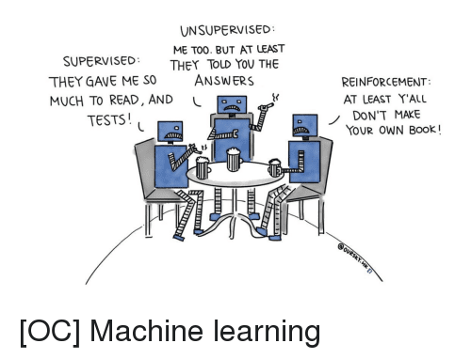
Types of Machine Learning System
[NOC]
The Machine Learning & Deep Learning Show: Lecture 01​

Slide 24
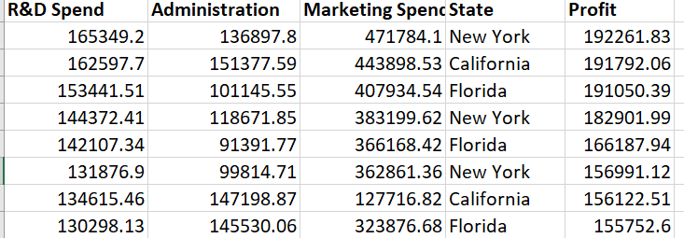
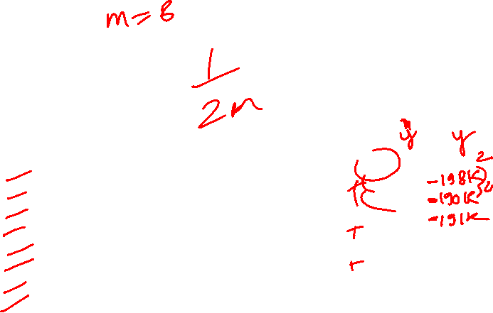
Supervised Machine Learning
Supervised ML
Regression
Classification
Labels
The Machine Learning & Deep Learning Show: Lecture 01

Slide 25
Classification vs. Regression !
CLASSIFICATION: In a classification problem, there might be test data consisting of photos of animals, each one labeled with its corresponding name. The model would be trained on this test data and then the model would be used to classify unlabeled animal photos with the correct name.
REGRESSION: In a regression problem, there is a relationship trying to be determined among many different variables. Usually, this takes place in the form of historical data being used to predict future quantities. An example of this would be predicting the future price of a stock based on past prices movements.
The Machine Learning & Deep Learning Show: Lecture 01

Slide 26
What are Features ?
Features are the variables which distinguish one example from another. They tell the machine learning model what parts of the data to look for patterns for achieving the goal.
Lots of data is crucial to a machine learning system but it needs to be helpful and relevant data. Though you never know until you experiment to see what variables truly make an impact.
The Machine Learning & Deep Learning Show: Lecture 01

Slide 27
An Example
Consider the problem, "Predicting the Price of a House"
What features should we use ?

Slide 28
Features :
Location
Number of bedrooms
No of floors
Size of property
Number of light switches?
Colour of house?
Parking Availability?
The Machine Learning & Deep Learning Show: Lecture 01

Slide 29
Weights & Bias:
Weights and biases (commonly referred to as w and b or Ѳ {theta} notation) are the learnable parameters of a machine learning model.
Weights control the signal (or the strength of the connection) between two neurons. In other words, a weight decides how much influence the input will have on the output.
Biases, which are constant, are an additional input into the next layer that will always have the value of 1.
The Machine Learning & Deep Learning Show: Lecture 01

Slide 30
Regression
Regression models attempt to model the relationship(s) between two or more variables (by fitting a curve / an equation to observed data).
For example, a modeler might want to relate the weights of individuals to their heights using a linear regression model.
The Machine Learning & Deep Learning Show: Lecture 01

Slide 31
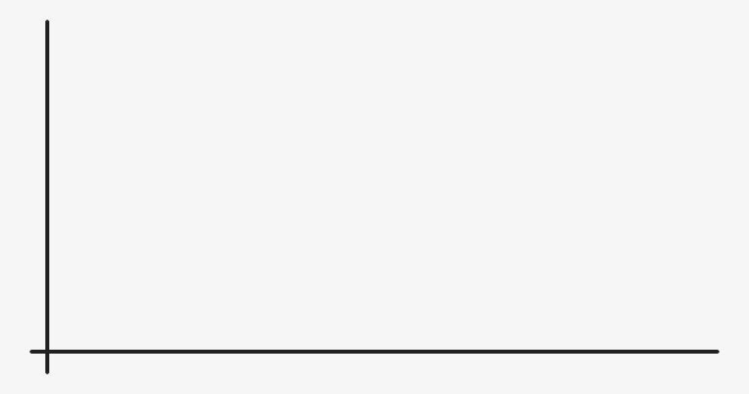
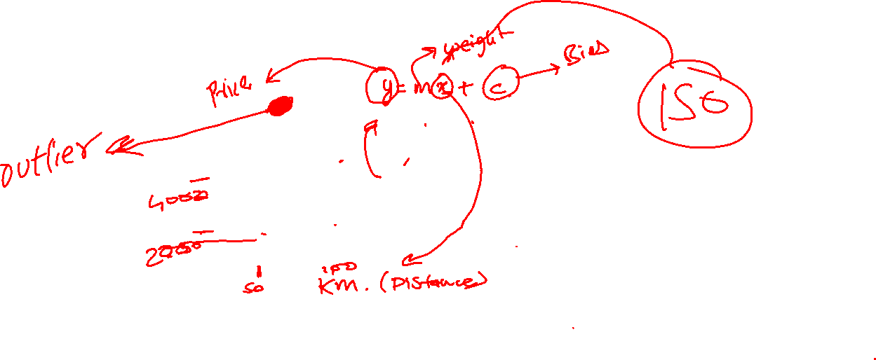
Regression
Regression systems can be as simple as drawing a line or more complex models depending on multiple variables.
The Machine Learning & Deep Learning Show: Lecture 01

Slide 32
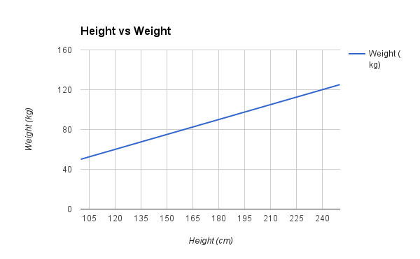
How to identify a Regression model ?
Regression systems output a number, they have continuous valued outputs, rather than discrete categories (as in classification)
The Machine Learning & Deep Learning Show: Lecture 01

Slide 33
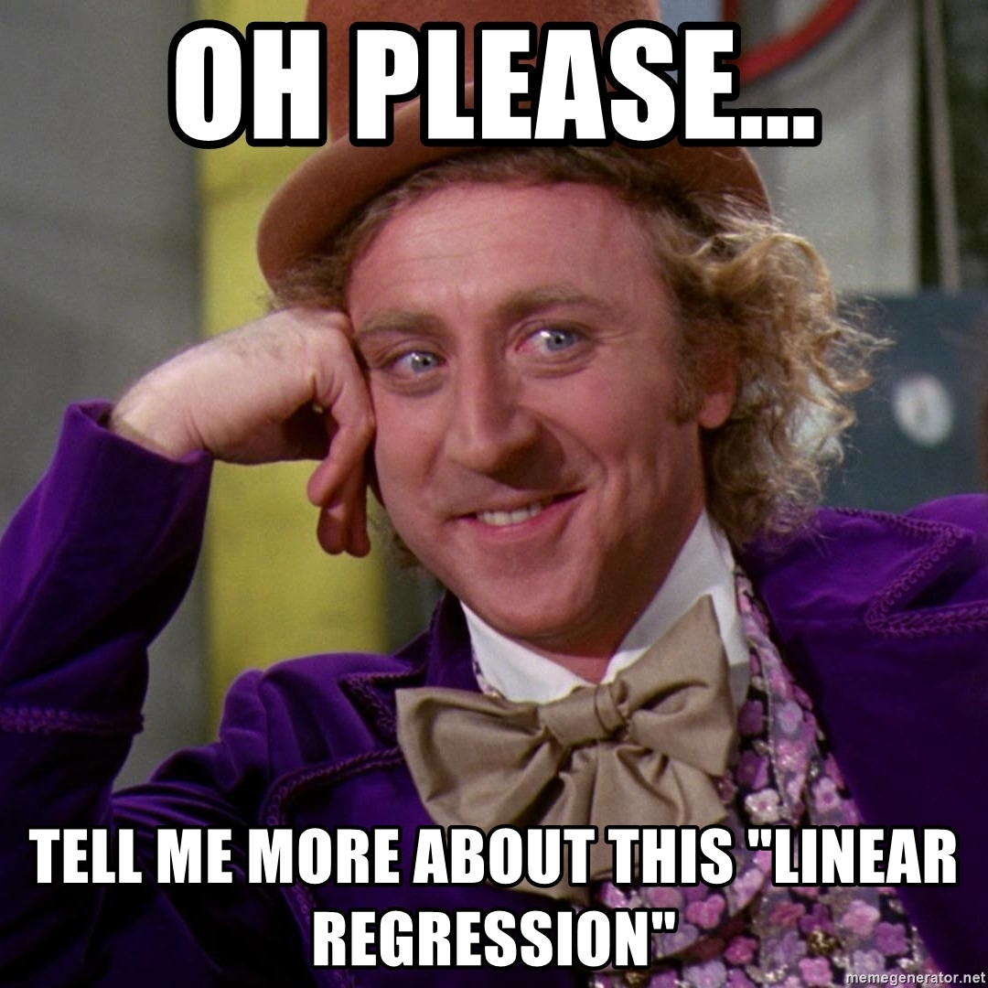
Ready to dive deeper?
The Machine Learning & Deep Learning Show: Lecture 01

Slide 34
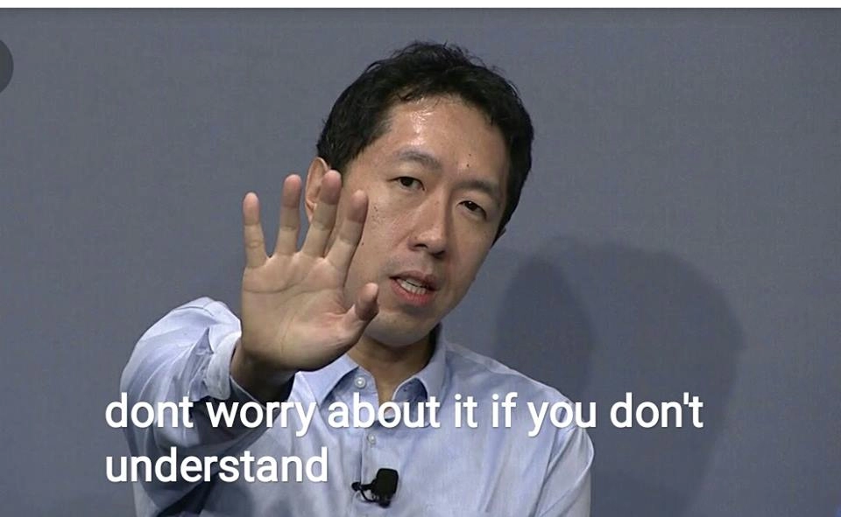
Ready to dive deeper?
The Machine Learning & Deep Learning Show: Lecture 01

Slide 35
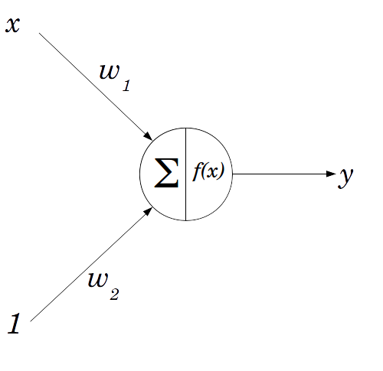
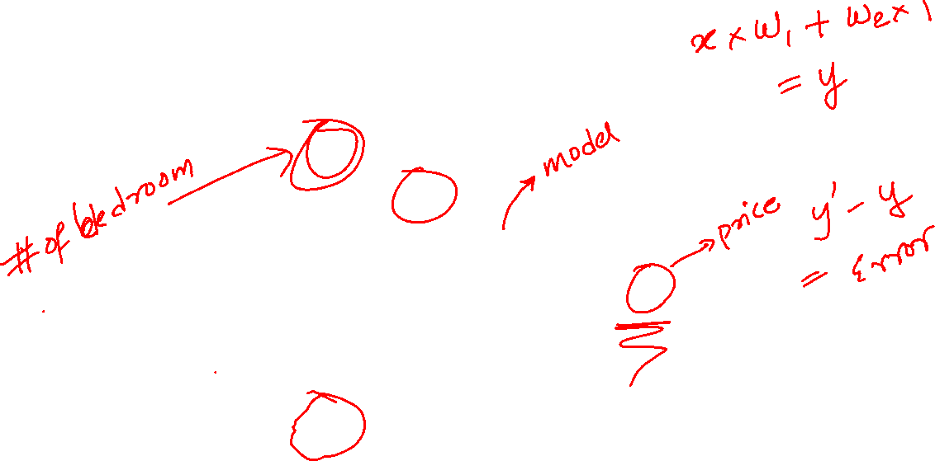
Linear Regression model
b
and
w1 and w2 can also be called Ѳ1{theta1} and Ѳ2 and b as Ѳ0
The Machine Learning & Deep Learning Show: Lecture 01

Slide 36
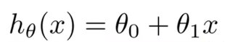
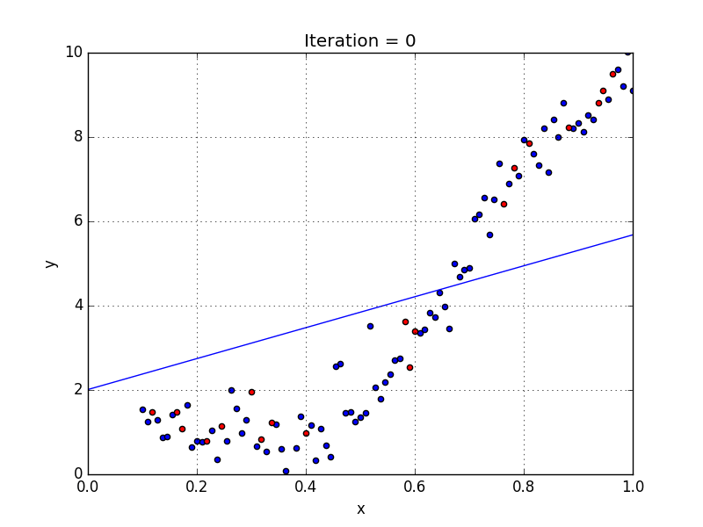
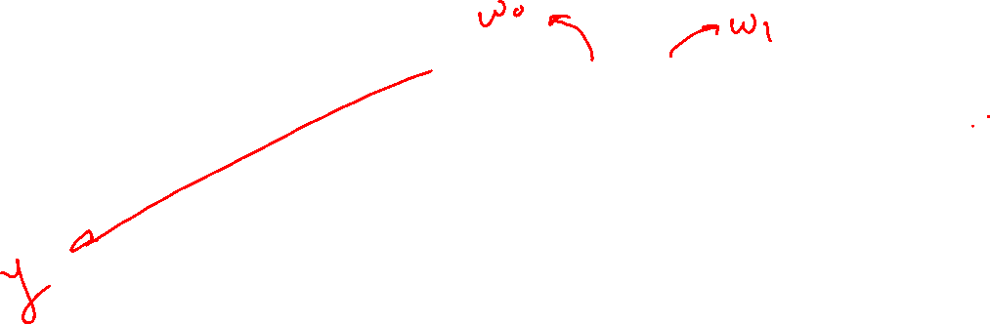
Linear Regression
The Machine Learning & Deep Learning Show: Lecture 01

Slide 37
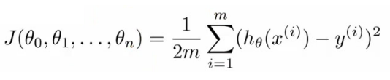
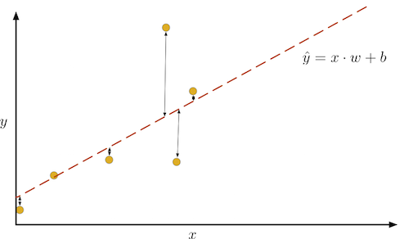
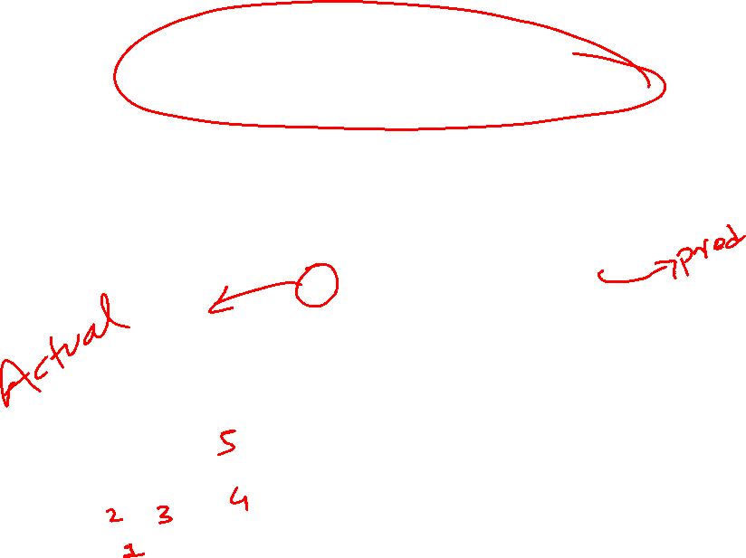
The Loss Function
To determine how well a model is doing, we measure the distance between the model's prediction (indicated in the graph by the dotted red line) and the example data (yellow dots). This is known as loss.
The Machine Learning & Deep Learning Show: Lecture 01

Slide 38
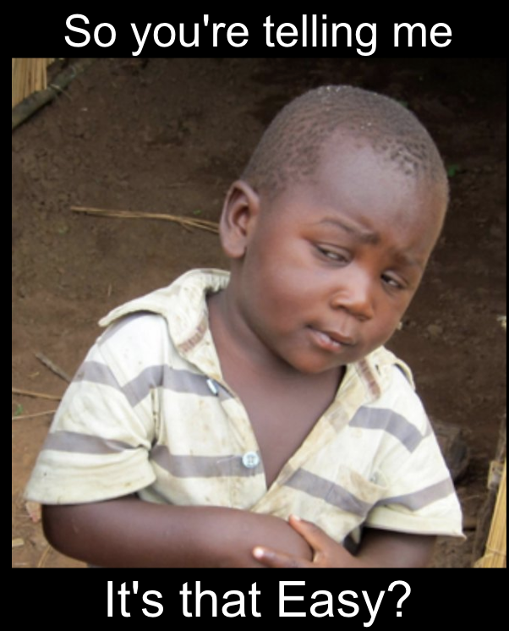
Gradient Descent
The Machine Learning & Deep Learning Show: Lecture 01

Slide 39
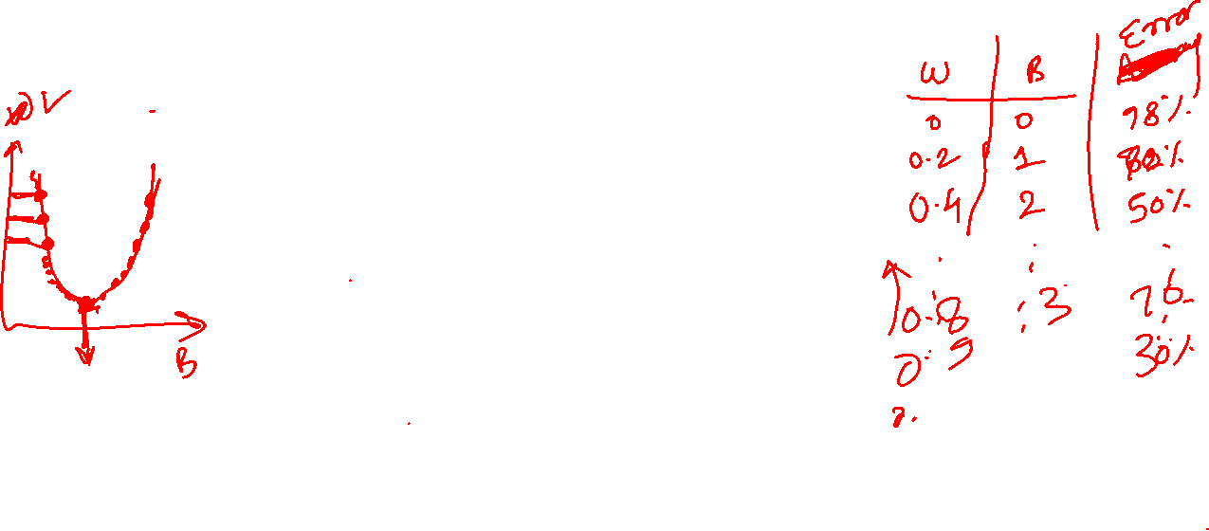
Gradient Descent
When there are one or more inputs we can use a process of optimizing the values of the coefficients by iteratively minimizing the loss of the model on our training data.
This is called Gradient Descent.
The Machine Learning & Deep Learning Show: Lecture 01

Slide 40
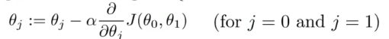
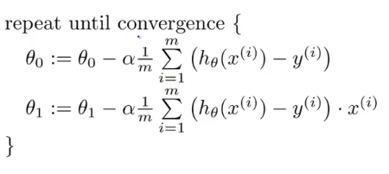
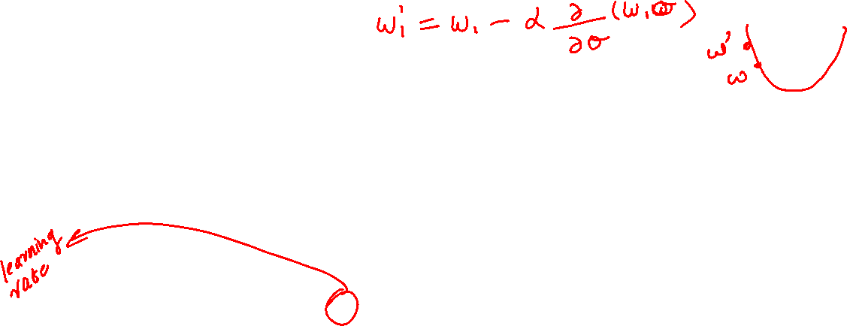
Gradient Descent
The Machine Learning & Deep Learning Show: Lecture 01

Slide 41

Don't use Linear Regression Blindly ;)
Meme credits: MLcourse.ai
The Machine Learning & Deep Learning Show: Lecture 01

Slide 42
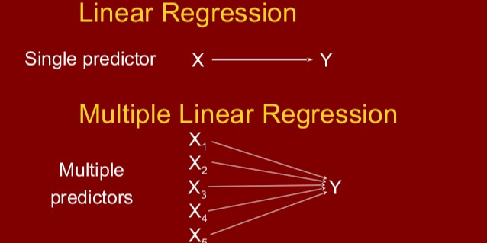
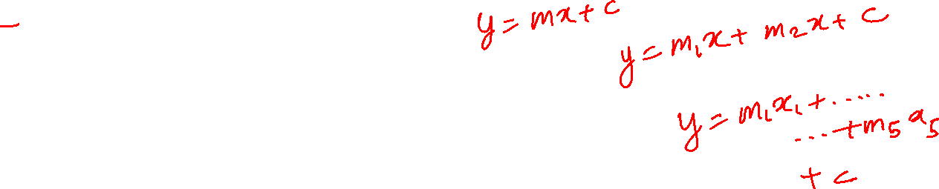
Multiple Regression
The Machine Learning & Deep Learning Show: Lecture 01

Slide 43
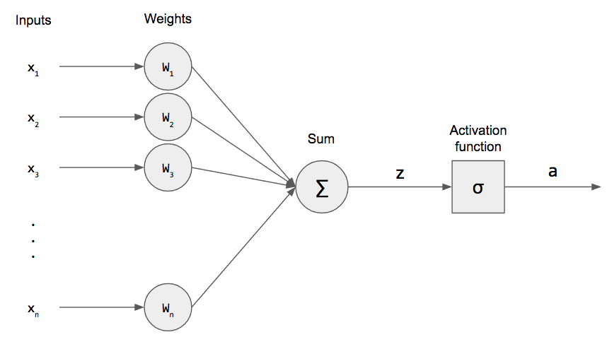
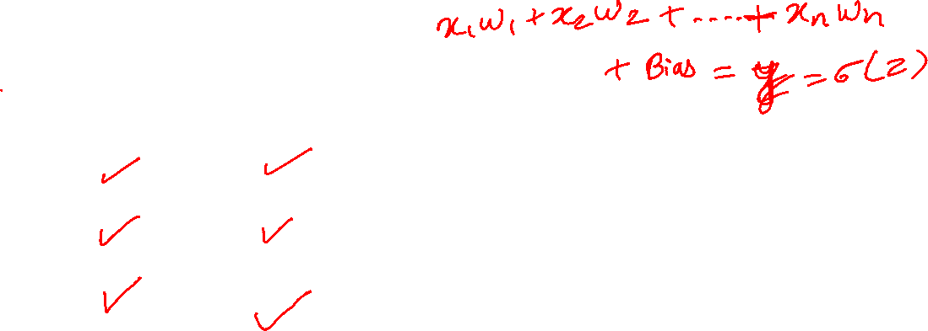
Multiple Regression
The Machine Learning & Deep Learning Show: Lecture 01

Slide 44
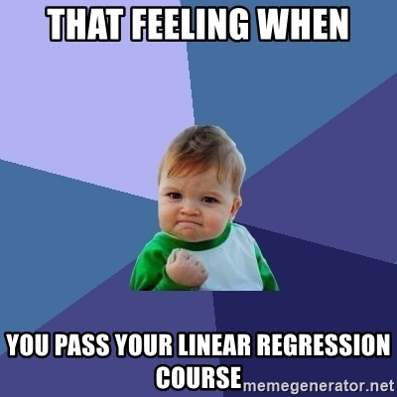
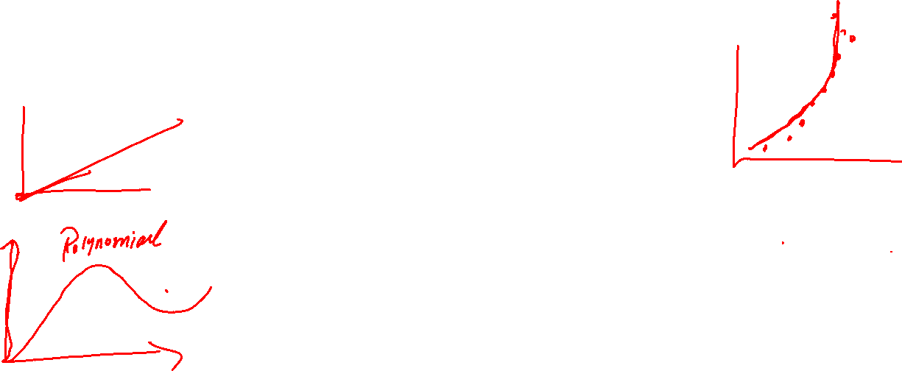
So that was Regression !!
The Machine Learning & Deep Learning Show: Lecture 01

Slide 45

The Machine Learning & Deep Learning Show: Lecture 01

Slide 46
Python??

Slide 47
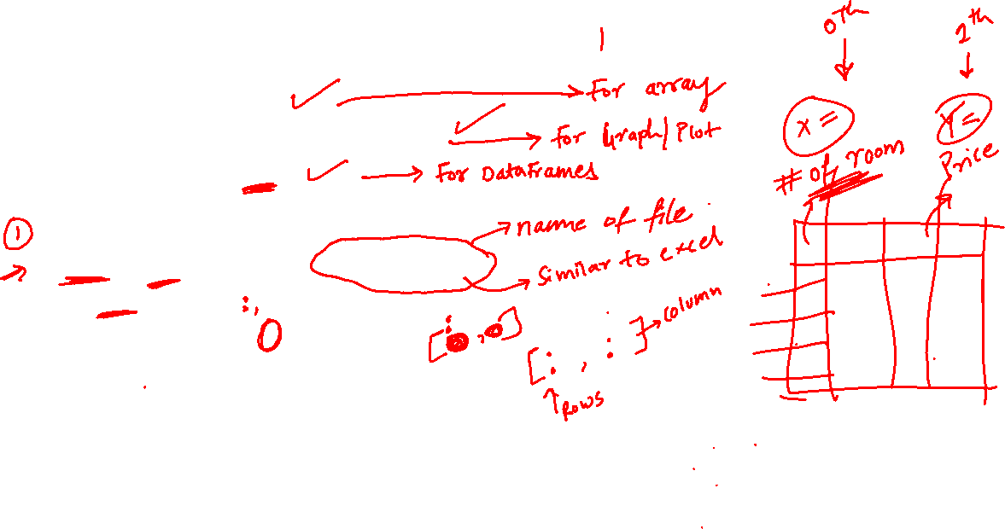
Code: Linear regression
import numpy as np
import matplotlib.pyplot as plt
import pandas as pd
#import data set
dataset= pd.read_csv('House Data.csv')
X= dataset.iloc[:,:-1].values
Y= dataset.iloc[:,1].values
#Splitting the data
from sklearn.model_selection import train_test_split
X_train, X_test, Y_train, Y_test
= train_test_split(X,Y,test_size= 1/3)

Slide 48

Code: Linear regression
#Fitting Simple Linear Regression
#This is called Model
from sklearn.linear_model import LinearRegression
regressor= LinearRegression()
regressor.fit(X_train,Y_train)
##Predicting the test results
Y_pred= regressor.predict(X_test)

Slide 49
Code: Linear regression
#Visualising the training set Results
plt.scatter(X_train, Y_train, color='red')
plt.plot(X_train, regressor.predict(X_train), color='blue')
plt/title('Price Vs Sqft Living(Training set)')
plt.xlabel('Sqft Living')
plt.ylabel('Price')
plt.show()
plt.scatter(X_test, Y_test, color='red')
plt.plot(X_test, regressor.predict(X_test), color='blue')
plt/title('Price Vs. Sqft Living(Test set)')
plt.xlabel('Sqft Living')
plt.ylabel('Price')
plt.show()

Slide 50
Code: Linear regression
#Giving External Data for Price Prediction
Data=np.array(4230)
Y_manualtest= regressor.predict(Data.reshape(1,-1))
print(Y_manualtest)
#if we want to take manual input from the user and then calculate the price
a=int(input('What is the Sqft living of your house?'))
Data=np.array(a)
useroutput= regressor.predict(Data.reshape(1,-1))
print(useroutput)

Slide 51
About Assignment 01

Slide 52

That's all Folks !
​

